Slide 1
Dual-Alarm Clock Radio
AJ, William, and Luke (DaLAW)

Slide 2
Our Vision (other than get an A)
Create software to model the logic of a dual-alarm FM/AM Radio Clock.
Learn the process of Software Development while completing this task.

Slide 3
The Process: Use Cases
UC 1: Using Alarms
Pre-Conditions: The clock time is correctly set
Success Guarantee: The alarm goes off at the specified time
UC 2: Listening to the radio
Pre-Conditions: Radio can recieve transmissions and respond to software
Success Guarantee: The station is playing and user controlled
UC 3 : Setting Clock Time
Pre-Conditions: There is already some time set
Success Guarantee The clock time is changed
Notes:
Use case names
(Talk about them later)

Slide 4
The Process: Modeling...
Notes:
Domain Model, Use Case Realization, Sequence Diagrams, UI State Diagrams

Slide 5
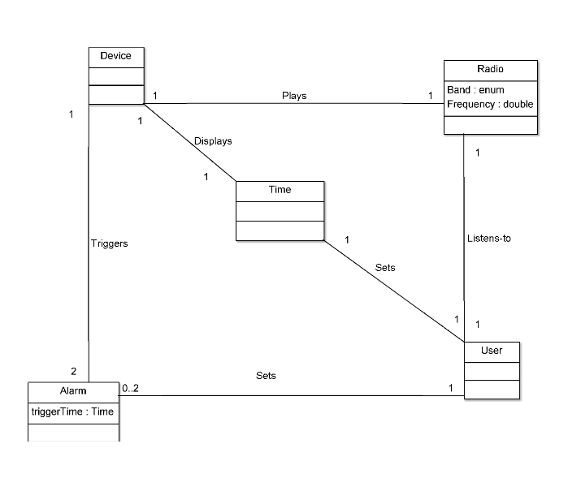
Domain Model

Slide 6
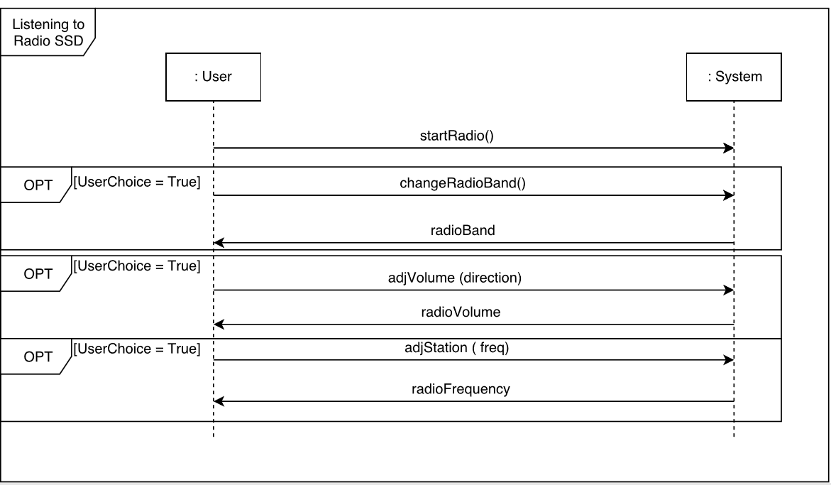
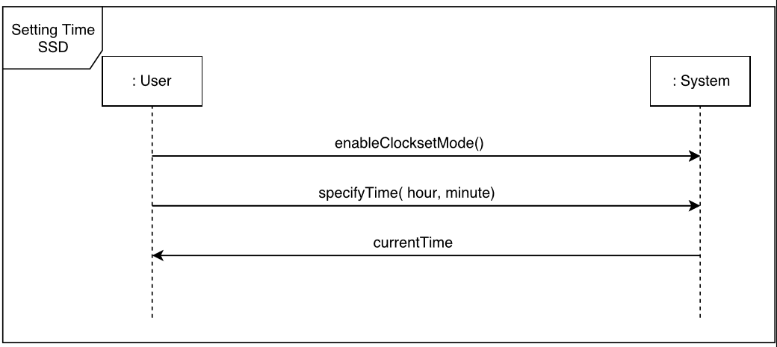
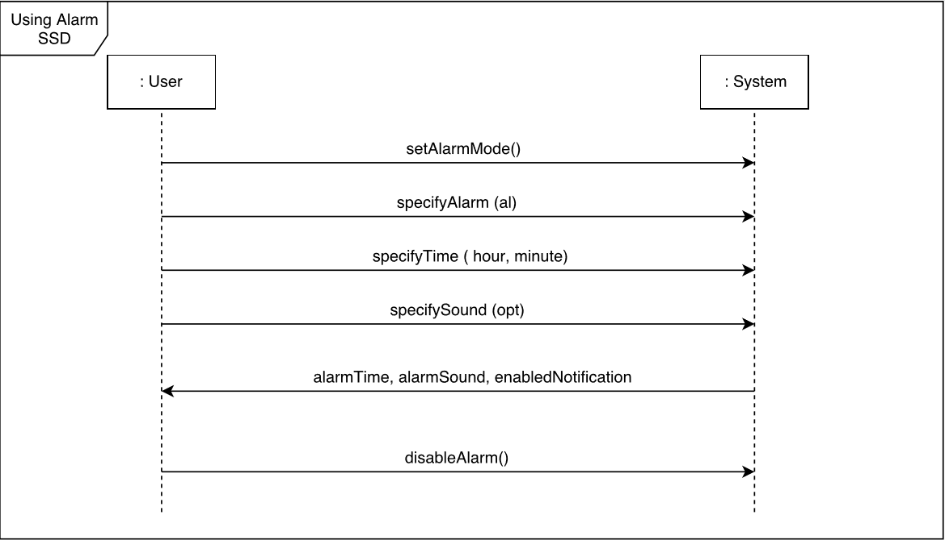
Sequence Diagram

Slide 7
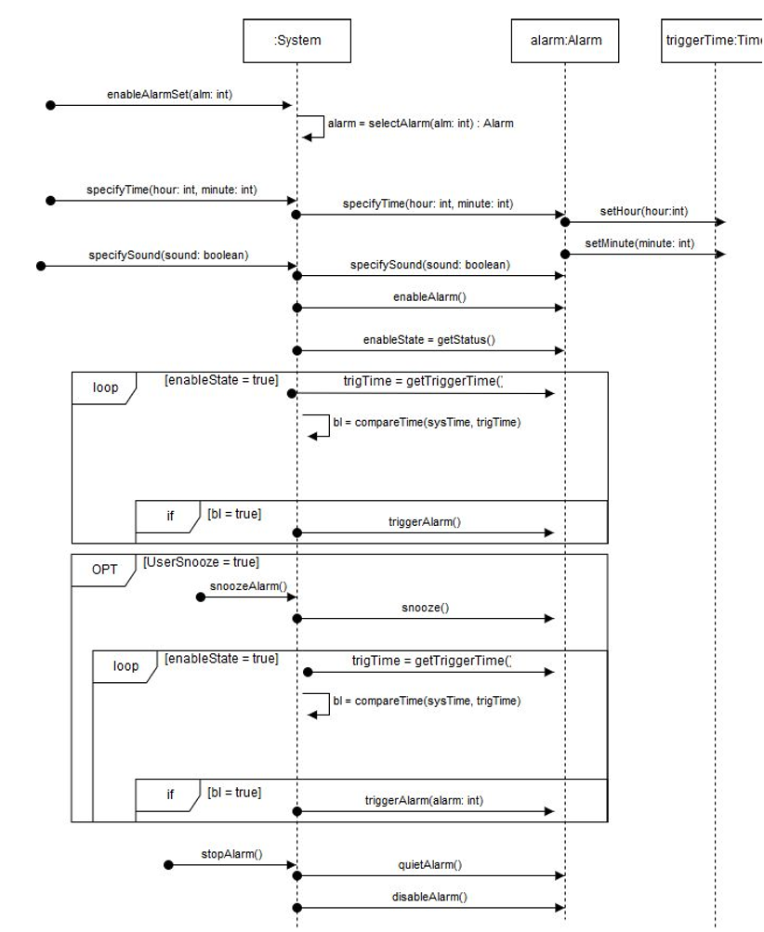
Use Case Realization: Dual-Alarm

Slide 8
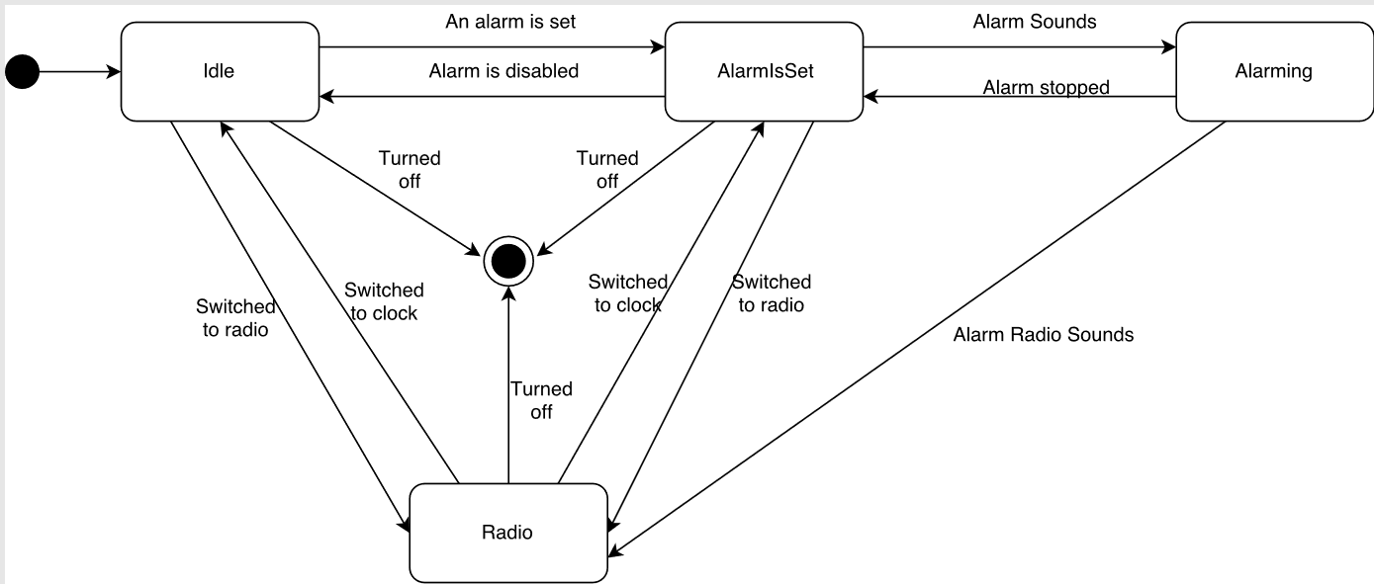
UI State Diagram

Slide 9





The Process: Implementation
Coded in Java in the Netbeans IDE, using JavaFX for UI through Scenebuilder.
GitHub for collaboration and code storage
GroupMe for team communication

Slide 10
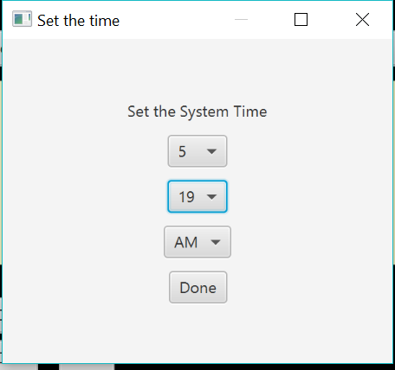
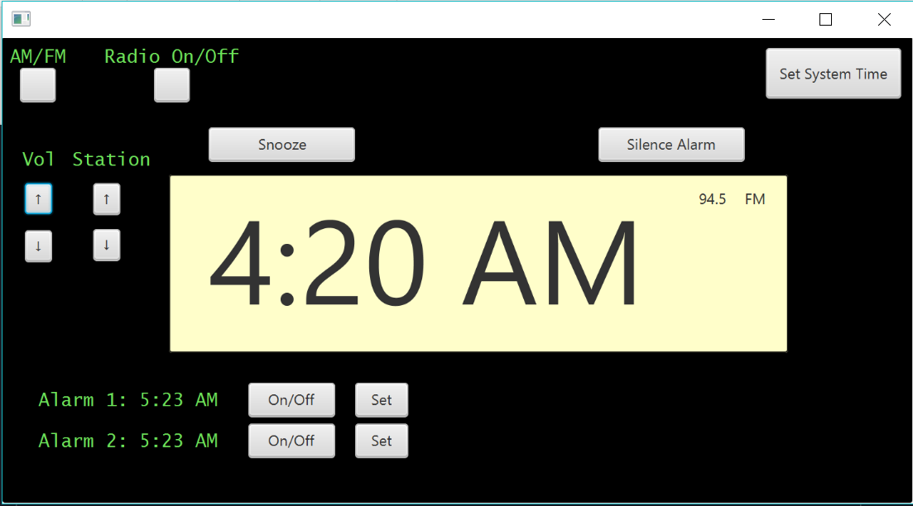
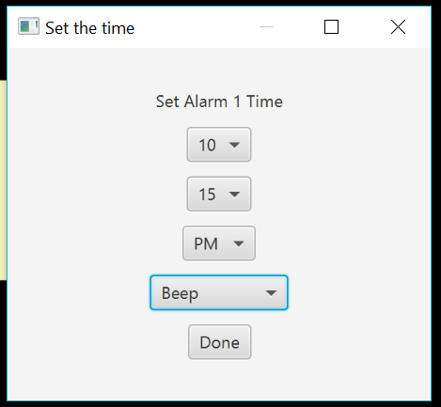
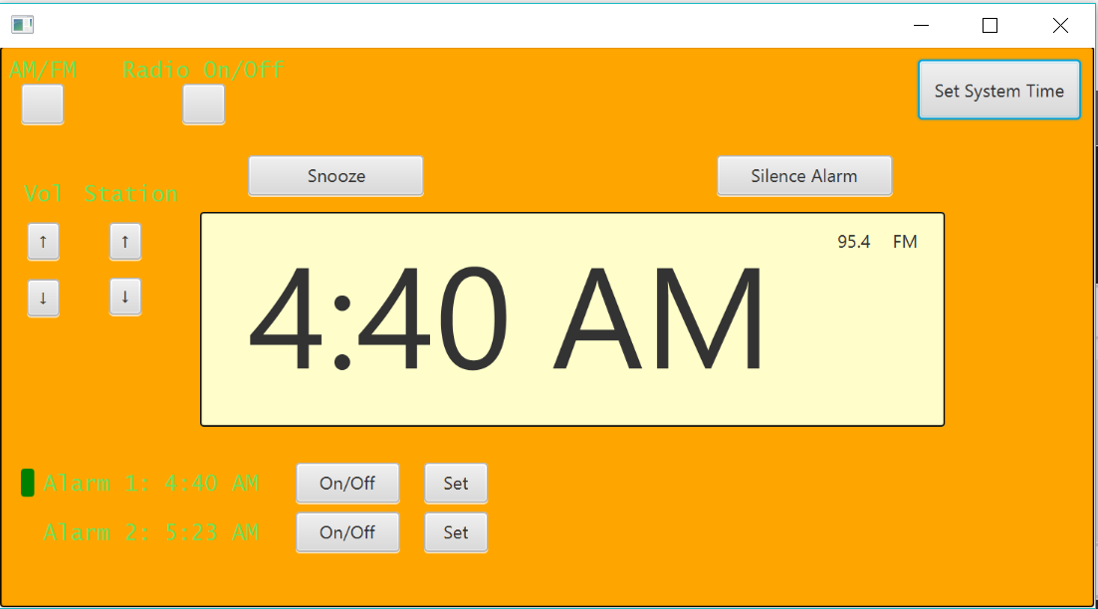
The Process: Presenting Implementation
Notes:
Tab to Live Demo After this slide

Slide 11
Post-Process: Reflection on Difficulties
Prior planning was inadequate for actual implementation
Working with unique classes and their behaviours and limitations
Notes:
Final Project Doesn’t match Initial Planning, Pop-ups and other coding problems, Github issues

Slide 12
Post Process: Lessons Learned
Models are helpful when transitioning from ideas to code
There will be deviations from the models
Models should not take up a large amount of time
Notes:
Modeling is helpful
Don’t Focus on Modeling

